Slide 1
Child Development

Slide 2
Understanding Child Development
Social Development involves the interaction of variables affecting the child, the family, and the broader community
Explore the article Why Chinese Mothers are Superior and the reactions to “Tiger Mom”

Slide 3
Different theoretical orientations relevant to a child’s cognitive and social-emotional development.
Classic influences of:
Erikson, Piaget and Kohlberg

Slide 4
Contemporary challenges of “Hothouse Babies and Children”
Children whose parents push them into learning more quickly than appropriate for developmental age
Attempt to protect/nurture in an environment which creates a “super baby”

Slide 5
Review the major Developmental Theories with an emphasis on child development practices.
Research indicates that more knowledge about child development promotes positive parent/child relationships

Slide 6
Issues of temperament and development for younger children (Thomas and Chess)
Temperament is an independent psychological attribute (although interacts with motivation, arousal…)
Expressed as a result or response to an external stimulus, opportunity or demand

Slide 7
Difficult babies: irregularity of biological functions; tendency to withdraw from new situations/stimuli; slow adaptability to change, negative mood responses
Slow-to-Warm: low activity levels, adapt slowly, withdrawn; somewhat negative mood; wariness in new situations

Slide 8
Easy babies: regular internal scheduling and approach to world; like to engage, adaptable, positive mood responses
Goodness of fit: opportunities, expectations and environmental demands matching with child’s temperment and characteristics

Slide 9
Penelope Leach: idea that each infant is unique with a set of experiences in utero, during the birth process and after birth. Parental expectations can match the child or not. Key is how to “adjust” to your baby
4 categories of babies: miserable, jumpy, sleepy and wakeful

Slide 10
Miserable Babies: “inclined to the miseries”; hard to settle, ravenous, slow and difficult to feed, wakes often, unsettled
Acknowledge this kind of child can be demoralizing and depressing
Shifts direction of blame from the parent
Attempt to provide warmth, stability; swaddle; ease and limit transitions

Slide 11
Jumpy babies: responses to environmental stimuli are extreme; frightened of almost everything; could have low stimulus barriers, physical contact can increase anxiety.
Leach suggests child will calm with maturation; prepare for changes. Understand and respect babies needs and alter behavior: gently approach

Slide 12
Sleepy Babies: hard to engage, often tired and less responsive. These babies need more opportunity for stimulation when awake
Wakeful babies: awake, alert and active for extended periods of time. Need more stimulation, talk, change positions and activities to keep invested in world

Slide 13
Buss and Plomin Temperamental Variables
Emotionality: distress
Ranges from stoic lack of reaction to intense emotional response (out of control)
Activity: tempo, vigor
lethargy-intense or extreme energetic behavior
Sociability: connection with others preference for others vs. being alone

Slide 14
Piaget’s Theory of Cognitive Development

Slide 15
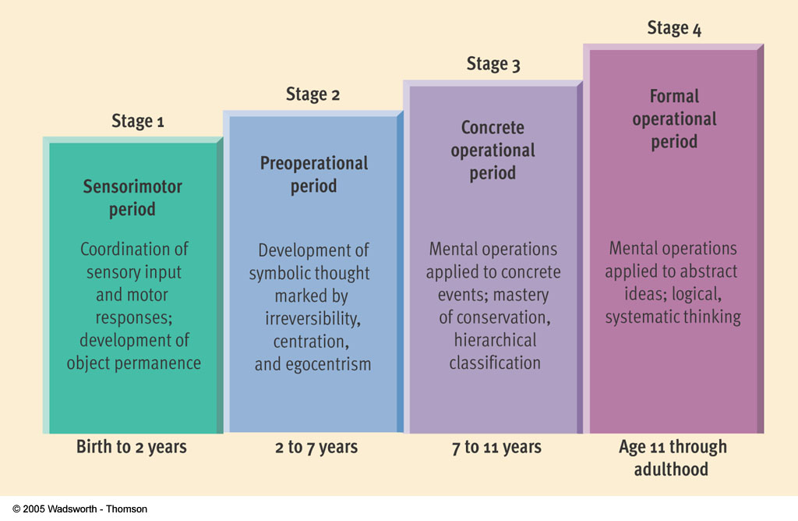
Figure 10.7, page 304
Figure 10.7 Piaget’s stage theory.

Slide 16
Erikson’s Psychosocial Theory of Development
(Eight stages of Man)

Slide 17
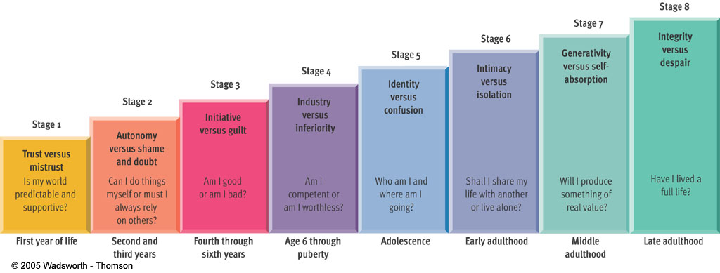
Figure 10.6, page 303
Figure 10.6 Erikson’s stage theory.

Slide 18
Look at the influence of cognitive ability and emotional development on development and parental expectations
Piaget’s Sensorimotor (0-2) and Erikson’s trust vs mistrust. Develop attachments/ sense of permanent objects and a sense of dependability in the world.
Children need predictability; orientation is the present: cannot spoil b/c not thinking about “next time”

Slide 19
Children at this phase are beginning to understand self as separate from other.

Slide 20
Piaget says that children learn about the world using all their senses:
touching, tasting, smelling.

Slide 21
Children are increasingly social in the later phases of this stage of development.

Slide 22
Piaget’s Preoperational phase (2-6) more action oriented, able to use representational thought about people, objects and events in absence. Able to pretend and use symbolic language. Should children share?
Toys are seen as an extension of self

Slide 23
Egocentrism: unable to take others perspective/viewpoint; but children have more empathy than previously thought.

Slide 24
Perceptual salience: kids focus on how things appear and focus on central elements only
Concrete thinking: idea of doing exactly what they are told
Failure to conserve and irreversibility also emerge. If a parent understands these flaws in thinking they can be more aware of how their child is thinking about the world—increasing mind-mindedness

Slide 25
Erikson sees time of autonomy vs shame and doubt. Children want to be in charge of their own bodies, explore and have an increased sense of autonomy.
Toilet training: allow children to make a mess, be in charge, and feel success

Slide 26
Efforts at autonomy and exploration of the world are not always seen as positive by parents and others.

Slide 27
Initiative vs Guilt (Erikson): curious about the world; need to question. Learn actions may impact others. No encouragement or opportunities to explore leads to powerless feelings, negative ideas about personal efforts and independent strivings
Too much independence is overwhelming

Slide 28
Piaget’s Concrete operations: increased cognitive flexibility; can retrace thoughts, self-correct and approach a task from multiple dimensions. Follow rules, see other viewpoint. Often a “dethroning” of parents
Erikson: Industry vs. Inferiority. Learn feeling of doing a job well or incapable. Unfortunately, those who feel incapable stop trying.

Slide 29
If parental encouragement is absent schools or others can take on this role.
In spite of parents efforts, we can see how peers and schools can impede progress

Slide 30
Formal operations: adolescent thinking is logical, can discuss values and metaphor. Increasingly complex attachment to parents seen.
Sleeper effect: recast earlier memories assigning intent, motive

Slide 31
Erikson: Identity vs Role-Confusion: See unique and integrated self developing
Peers and parents also play a role in self-definition, moral development and behavior
The interactions with peers, parents, schools and its role in development need be considered

Slide 32
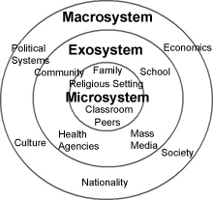
Bronfenbrenner’s Ecological Theory

Slide 33
Microsystem: social relationships and
settings a person experiences daily
Exosystem: social structures which directly or indirectly affect a person’s life (family and work; parental support networks, cmmunity resources)
Mesosystem: the connections and interrelationships among microsystems (e.g how well the school and parents interact and share values; how parental relationships can enhance or impede social skills with peers., family and daycare)

Slide 34
Macrosystem: overarching cultural patterns of a society; values, ideologies, laws of society
Chronosystem: Time-based elements which impact all the systems, socio-historical context impacts development at all levels

Slide 35
Parenting style and child outcome research
(Baumrind)
Authoritarian: restrictive parenting; insist on obedience, rigid rules; no explanations and insensitivity. Preschoolers were moody; easily annoyed, unfriendly, less motivated
Authoritative: assume control with flexibility; reasonable demands; provide reasons for rules/decisions. Preschoolers were cheerful, socially responsible; achievement oriented and cooperative

Slide 36
Permissive: accepting and lax with few demands; little monitoring; few controls. Preschoolers were impulse, aggressive, bossy self centered, low in independence and achievement
Uninvolved (Maccoby): removed or hostile parenting; overwhelmed with own stressors have little time or energy to parent. Children high in aggression, temper tantrums, perform poorly in classroom, limited social skills.

Slide 37
Parental Discipline
Love Withdrawal: withholding attention, affection or approval; creates snxiety over loss of love
Power Assertion: asserts power (commands, spanks, withdraw privilege); creates fear, anger or resentment

Slide 38
Induction: explaining why behavior is wrong; how it affects others; suggests ways to correct, increases empathy

Slide 39
Piaget and morality:
Heteronomous: (4-7) subject to others’ law
Autonomous: (7-11) subject to one’s own law
Older children take intent into consideration
Younger children consider consequences more; give more weight to intent when consequences are positive

Slide 40
Kohlberg and Moral Development in action.
Relationship to cognitive sophistication is seen, but not a direct correlation.
In one moral dilemma children were asked whether a child should tell his father about a misdeed his older brother had committed or heed his brother’s request to keep silent
Responses illustrate various elements of Kohlberg’s stages identified in the next slide

Slide 41
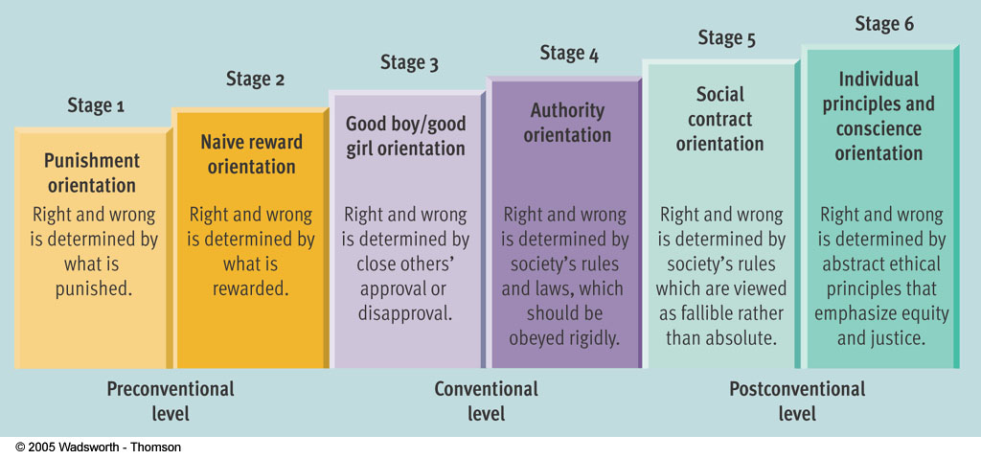
hiii
Figure 10.10, page 308
Figure 10.10 Kohlberg’s stage theory.

Slide 42
Prosocial Behavior and Altruism
Prosocial Behavior: Any action intended to help others
Altruism: The motivation for helping someone. Help without any thought as to what you might get in return.
Seen as a developmental process promoted by interactions between the child and environment,
___________________________________________

